Slide 1
MATHS & TECHNOLOGIES FOR GAMES
ADVANCED GRAPHICS:
SCENE POST-PROCESSING
CO3303
Week 11-12

Slide 2
CONTENTS
Back Buffer Usage - Recap
Full-Screen Post-Processing
Types of Post-Process
Area Post-Processing
[DirectX Sample Documentation for details and examples]

Slide 3
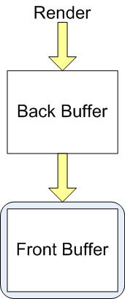
THE FRONT & BACK BUFFERS
The visible viewport is sometimes called the front buffer
But a second off-screen back buffer is the usual render target
  We render to this off-screen bitmap
  So rendering process is not seen
After frame rendering, the back buffer is presented (copied) to the front buffer
  The copy is a very fast operation and will not be so easily seen as the rendering
This is a form of double-buffering
  A general technique of using a second buffer to avoid affecting the one that is in use

Slide 4
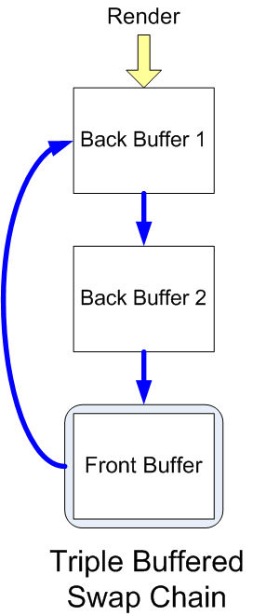
SWAP METHODS / CHAINS
Methods to get the back buffer content to the front buffer:
  Simple copy, back buffer discarded
    This is the usual method
  Swap the two buffers
    Useful if we want to keep the last frame
Can have more than one back buffer
  If two buffers, this is triple-buffering
  Improved concurrency with GPU (GPU finishes before frame is to be shown)
Multiple back buffers must use the swap method
  Called a swap chain

Slide 5
VSYNC OR NOT
Copy / swap to front buffer is a fast operation
  But not instant, it can be seen
Can perform it during the monitor's vertical sync
  VSync is a short time between each monitor refresh
  Any drawing operation in this time won’t be seen
But if you do this, FPS will be tied to monitor refresh rate
  E.g. Monitor at 60Hz, then FPS will be 60, 30, 20, 15 etc
Alternatively can copy to front buffer immediately
  FPS will reflect maximum performance
  But, will see tearing
    Horizontal bands between previous and current frame
    Most obvious when moving sideways

Slide 6
ALTERNATIVE RENDER TARGETS
Not necessary to render to a back buffer
We can render to a texture or to a specially created render target
We saw render-to-texture in Graphics module:
  Used it to render a mirror, and a camera viewpoint for shadows
  Such a texture needs to be specially created
For even more specialist needs we can create explicit render targets, or even render to multiple targets
  Will see this when we do deferred rendering
DirectX10 / 11 are very flexible in the use of render targets

Slide 7
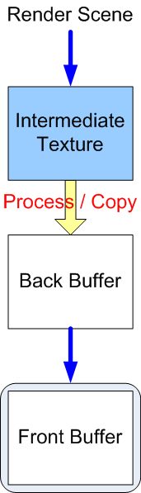
SCENE POST-PROCESSING
Assume we render the entire scene to an intermediate texture
We can then copy it to the back buffer to be presented to the viewport
  But we can also perform additional image processing during this copy
The copy process is effectively another rendering pass
  So we can alter the look of the entire scene using a pixel shader
  Use of a shader means much flexibility
This is full-screen post-processing

Slide 8
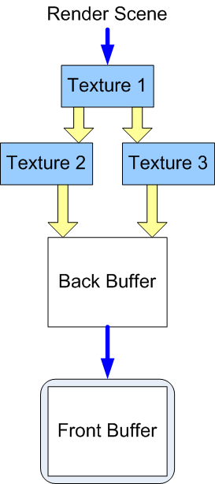
MULTIPLE PASSES / RENDER TARGETS
Can post-process in multiple passes:
  Render scene to a texture
  Render this texture in two ways into two more textures
  Combine the textures into the back buffer
  Maybe using blending (additive etc.)
The textures used do not have to all be the same size
  Scaling down into a texture, then back up to the back buffer is a common method to blur
Can make complex sequences of post processing for advanced effects
  See Bloom / HDR later

Slide 9
POST-PROCESSING TECHNIQUES
Wide range of possible techniques:
  Colour filters
  Blurs: motion blur, depth of field, bloom
  Distortions: e.g. heat haze, shock waves
  Feedback: motion blur (again)
  Film effects: grain, old film look, some lens effects
  Game effects: Night scope, predator-vision
  Generic 2D image filters: contrast, levels, edge detection etc.
  Image analysis: Calculate luminance, visibility coverage etc.

Slide 10
COLOUR FILTERS
A simple use of post-processing is a colour filter
E.g. a back & white filter:
  Render scene to a texture
  Render texture to back buffer using a special shader
  The shader converts each texture colour to grayscale
  Could use simple or complex technique:
    E.g. average R,G,B or full luminance calculation
Other possible colour filters:
  Adding a colour tint
  Sepia (like old photo)
  Gradient colour filter, animated gradients
  Complete colour remapping: e.g. a heat scope

Slide 11
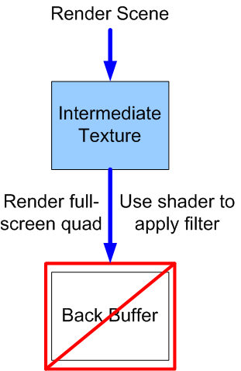
COLOUR FILTERS - DETAIL
Rendering a colour filter:
  Render entire scene normally to an intermediate texture
  Set up pixel shader to get pixels from a texture and tint the,
  Use this shader to copy & tint the intermediate texture to full-screen quad on the back buffer
    Quad is defined in 2D viewport space
    No vertex processing required since vertices are already in 2D
  Ensure texels match pixels
    Careful with UVs. No texture filtering

Slide 12
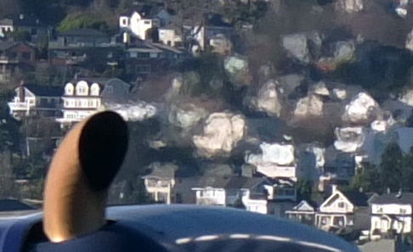
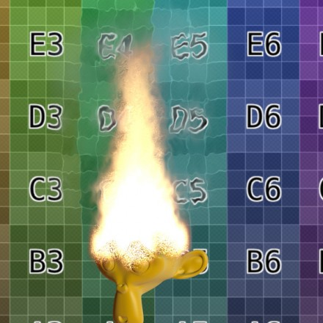
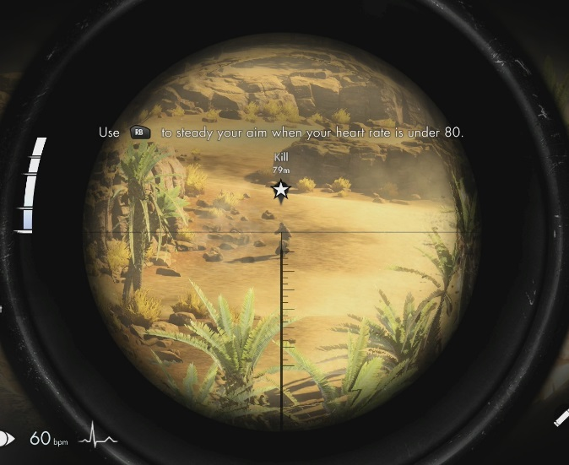
DISTORTIONS
A powerful class of techniques with a wide range of applications
In general:
  Render scene to a texture
  Render texture onto back buffer, but distorted
  Create distortion using geometry or shader work
Can distort entire viewport
  E.g. Looking through a sniper scope
Or only small areas:
  Overlay small distortions to create heat haze, shock waves etc.

Slide 13
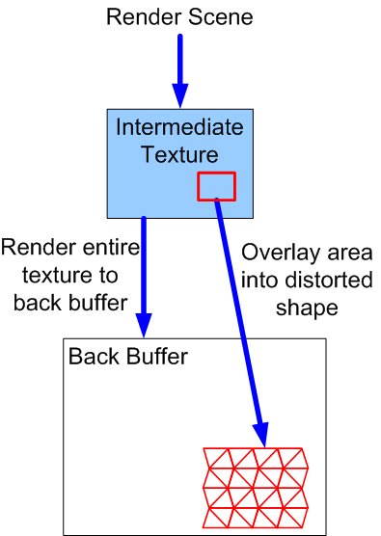
DISTORTIONS
E.g. Distortion of an area:
  Render scene to a texture
  Render texture onto back buffer normally (simple copy)
  Render a portion of texture into back buffer with distortion
  Typically alter UVs with the shader
  Or can use geometry as illustrated
    Useful if area animates (e.g. water droplets on screen)
  Can use look-up texture to assist with UV adjust (see lab)
Note the extra rendering pass compared to colour filter

Slide 14
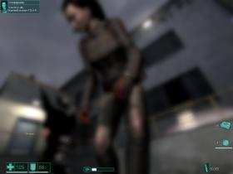
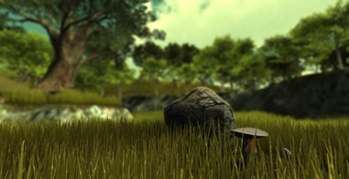
BLURS
Blurring a scene has several variants:
  Standard blurs (pixel averaging, Gaussian blur etc.)
  Depth of field – blur is stronger further from focal distance
  Bloom – bleeding of bright areas
  Motion blur – blur moving objects
Implemented in various ways:
  E.g. rendering via smaller texture
  Pixel shader to average a few local pixels
  Sometimes do horizontal and vertical as separate passes
Note: Motion blur can also be simulated using feedback

Slide 15

DEPTH OF FIELD
Depth of field describes the blurring of objects that are nearer or further than our focal distance
  Focal distance is the distance to the focus object
  The distance at which light rays will converge to a sharp image
  Eyes / cameras can adjust focal distance by manipulating lens
Rendering true depth of field is complex
Example simple solution using post-processing:
  Render scene to texture, also store depth values in a separate texture/render target or in alpha channel
  Blur the scene into another texture
  Render blend of the sharp and blurred texture into the back-buffer
    Depending on the original depth values
    Pixels close to focal length rendered from sharp texture, give more weight to the blurred texture for pixels away from focal length

Slide 16
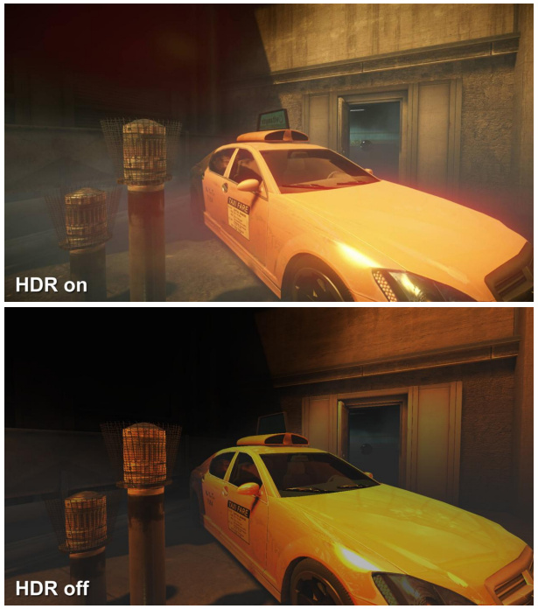
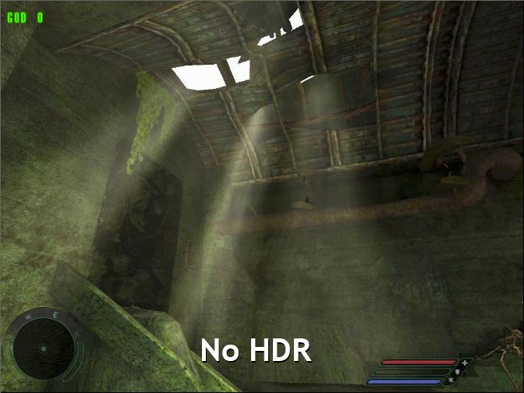
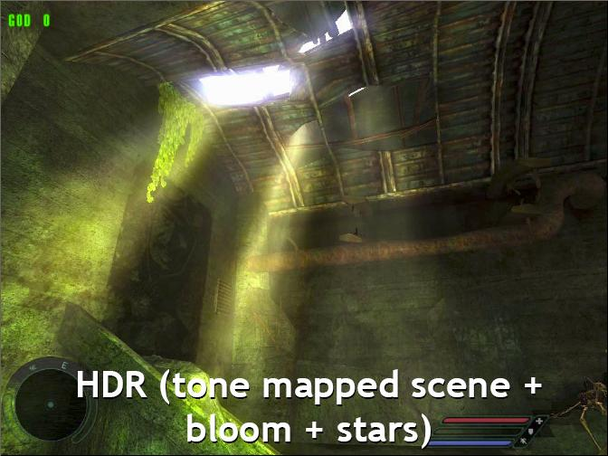
BLOOM / HDR
Monitors cannot show the full dynamic range that we can see
  Typical monitor displays 0-255 brightness
  Brighter colours are clipped
  Dark colours compressed into few values
Can use a high dynamic range (HDR)
  Use floating point colours
  But monitor can't display result
Use tone mapping to convert HDR result to monitor range
  Use post-processing to give the impression of a high dynamic range
  E.g. bloom: the bleeding of bright light
  Simply a blur of the bright parts

Slide 17
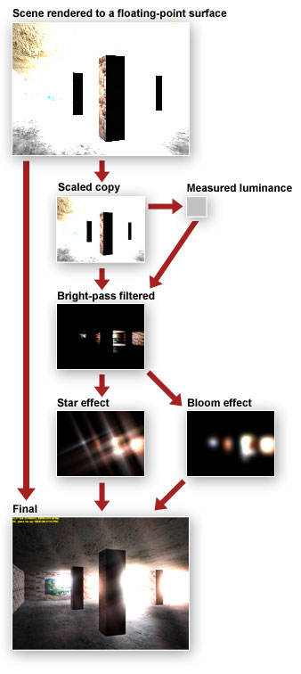
BLOOM / HDR
Bloom is part of a multi-pass HDR rendering process:
  Render HDR scene to floating-pt texture
  Copy scene to back buffer using tone mapping – use measured luminance to convert HDR range to LDR range
  Copy to another smaller texture (1/4 size) for efficiency
  Filter out all but bright areas
  Blur the pixels to give final bloom
  Render bloom over back buffer using additive blending
Each stage is a render pass
  Some stages can take more than one pass (blur is often 2-pass)

Slide 18
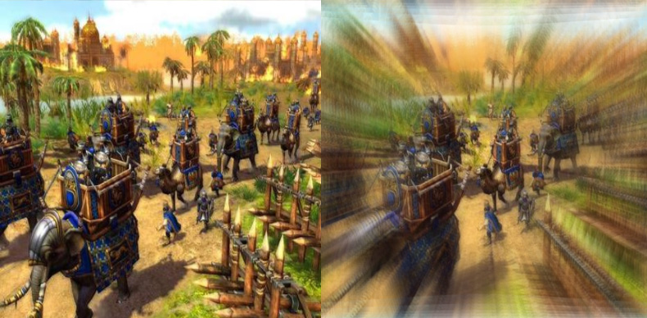
SIMPLE MOTION BLUR
Can use last frame as an input (a texture) to render the current one
  A form of feedback
Easiest method is to blend new frame with previous back-buffer
  Must ensure we are swapping front and back buffer
  Must not clear back-buffer pixels
Or retain intermediate texture used for post-processing from last frame
Used to create motion blur effects
  Can be combined with distortion or other post-process

Slide 19
AREA/POLYGON POST-PROCESSING
Most effects described so far affect the entire viewport
Sometimes want to post-process only a portion, e.g:
  Rectangle, circle or other area
  A specific 3D polygon
The distortion was an example of case 1, using a rectangle
Case 2 occurs with unique model materials
  E.g. Water, rippled glass etc.

Slide 20
AREA POST-PROCESSING
Often we wish to post process the area around a known point in the world
  For example, heat distortion due to an engine exhaust
Convert the world point to a screen point
  Covered this as part of picking
Get dimensions of the processed area
  Similar world- screen conversion with distance
Proceed as distortion example
  Usually render to a quad, just not full-screen
May need to take account of depth
  Unlike full-screen effects, area effects may be hidden behind other objects in the scene. Ensure quad has proper depth.

Slide 21
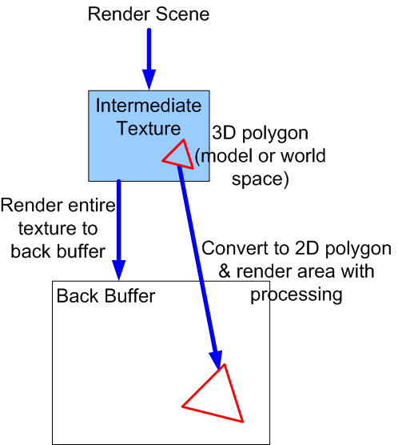
POLYGON POST-PROCESSING
May wish to post process an actual model polygon
  E.g. Rippled glass in a door
Render intermediate texture as normal
Not copying to quad this time, instead need to calculate the target 2D polygon
  Need UVs of poly in intermediate texture
  And 2D position of polygon in back buffer
Use special shader or picking methods
  Subtle detail, requires close understanding of the exact process
Render with post-processing in either case

Slide 22
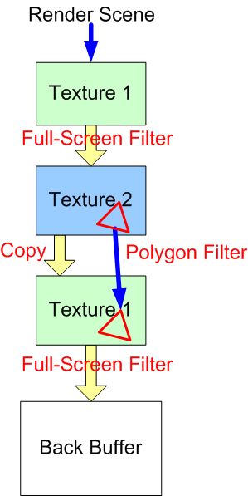
REUSING/CHAINING RENDER TARGETS
Reuse textures when performing several post-processing passes:
  Render scene to texture 1
  Next pass copies scene with full-screen or area effect into texture 2
  Next pass copies back to texture 1
  Repeat, only two textures required
  Final pass copies into back buffer
Can build a flexible (scripted) system for generic post-processing
More efficient to combine passes into a single pass where possible
  But lose flexibility

